Slide 1

Royal College of Art Students’ Union
Election Results
Presented by George Blake, SU Director
26 March, 2026

Slide 2

A Big Thank You
The RCA Team - your help and generosity make this possible - many thanks
Candidates - Your fantastic campaigning meant we got loads of engagement - thank you
Students - Democracy doesn’t work without you and you came out to vote in your hundreds - well done
Officers - You did so much to get students engaged, both in running for election and in voting - great job
SU Staff Team - It’s been ridiculously busy, well done for getting through it - thanks for all your support

Slide 3
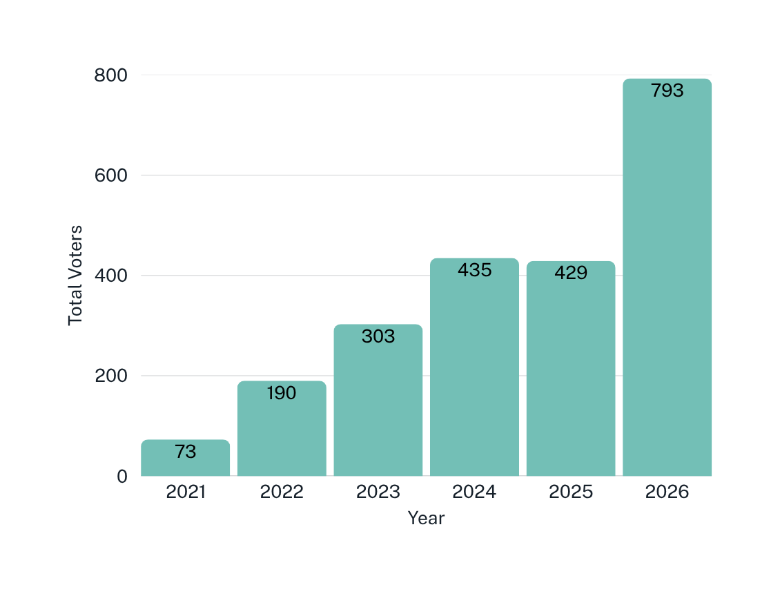
Voting Totals
Percentage of students who voted
How well we did
To beat last years turnout of 17% we needed 399 voters.
Thanks to all your hard work we got a record high turnout of 34%!
This is the highest turnout we have any record of so a massive congratulations to all of you!
15%
17%
34%

Slide 4
How Our Elections Work
 | Ranked Preference System |  | Voters rank candidates in order of preference. Voters can list just one candidate but can rank as many as they wish.
 | Quota |  | Candidates have to reach a quota of votes to be elected. The quote is half the voters plus 1.
 | Rounds |  | If no candidate reaches the quota, then the candidate with the least votes is eliminated and their votes go to their second preference candidate.

Slide 5
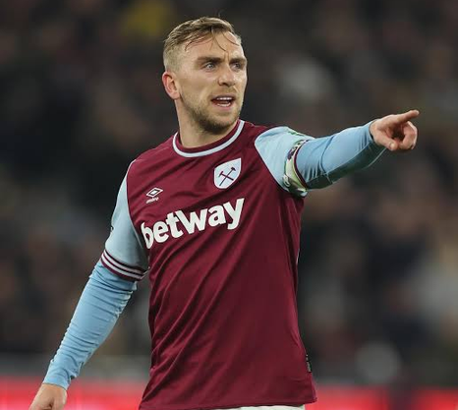
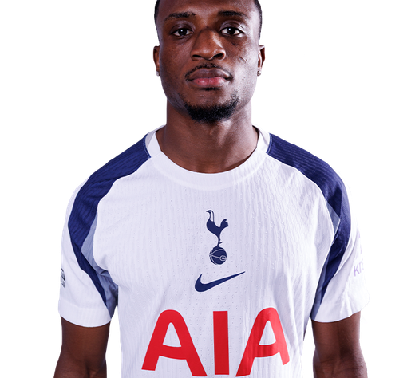
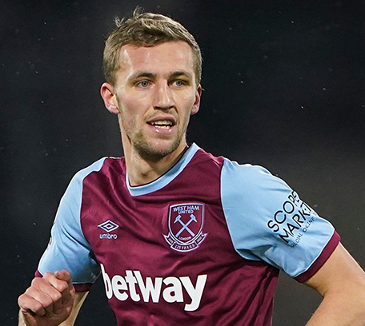

Candidates - Example Election
Bowen
Kudus
Soucek
R.O.N.

Slide 6
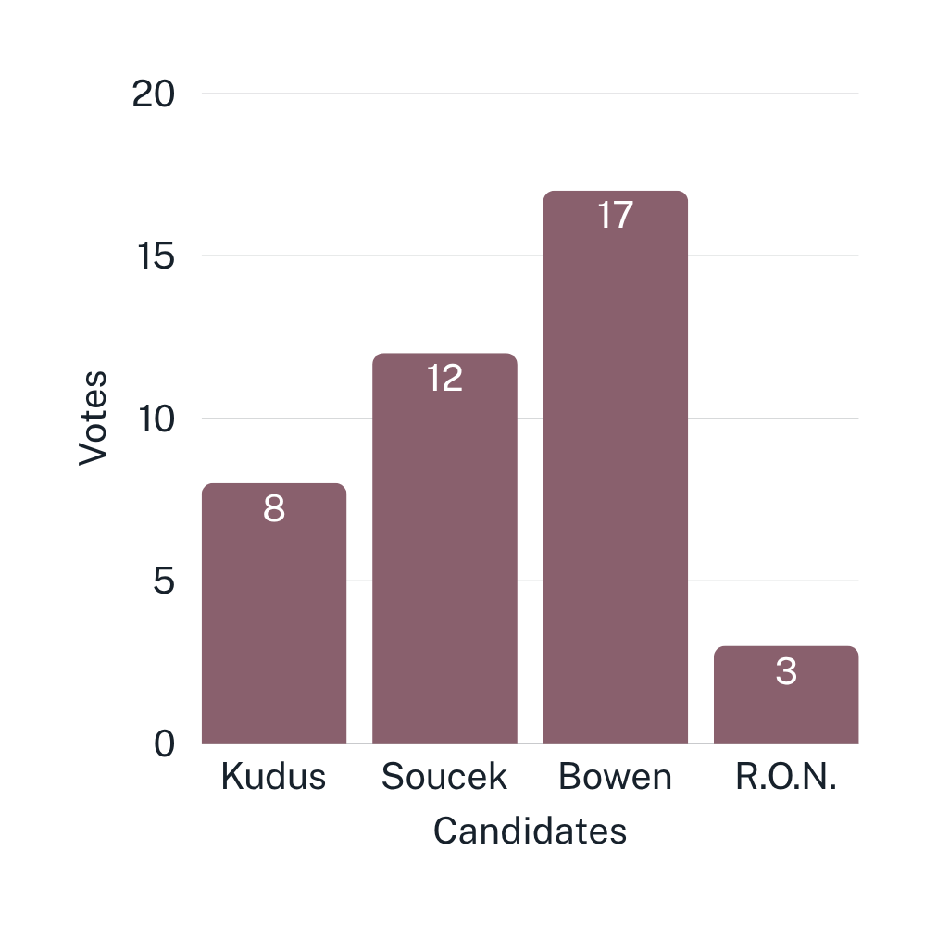
ROUND 1
Example Election
THE QUOTA TO BE ELECTED IS: 21
Who is your favourite West Ham player
R.O.N IS ELIMINATED
Because no candidate reached the quota the candidate with the least votes is eliminated and their votes redistributed.

Slide 7
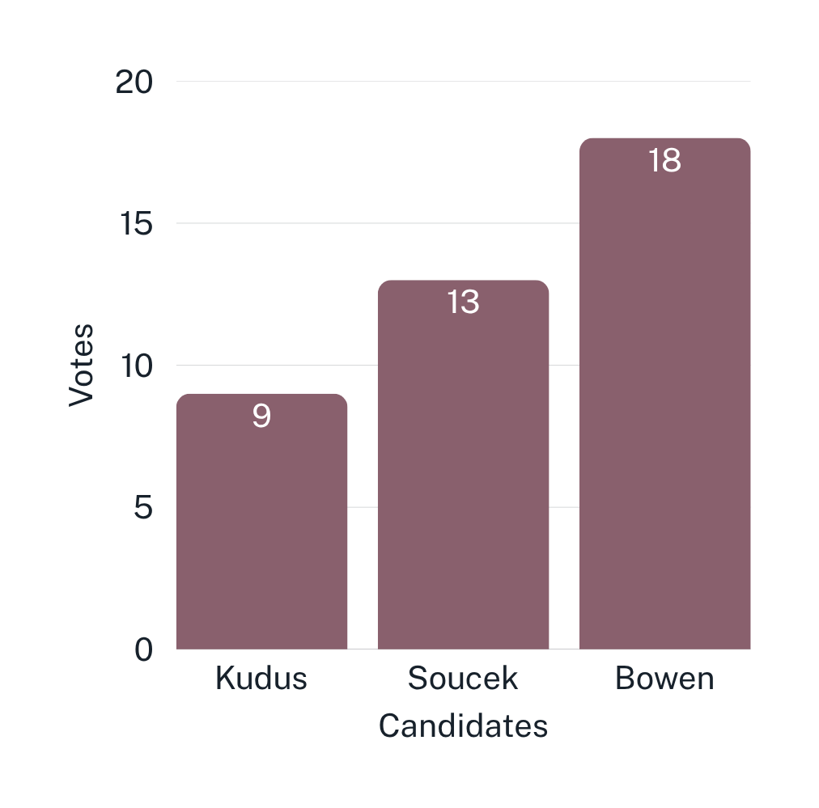
ROUND 2
Example Election
THE QUOTA TO BE ELECTED IS: 21
This one isn’t real
KUDUS IS ELIMINATED
Because no candidate reached the quota the candidate with the least votes is eliminated and their votes redistributed.

Slide 8
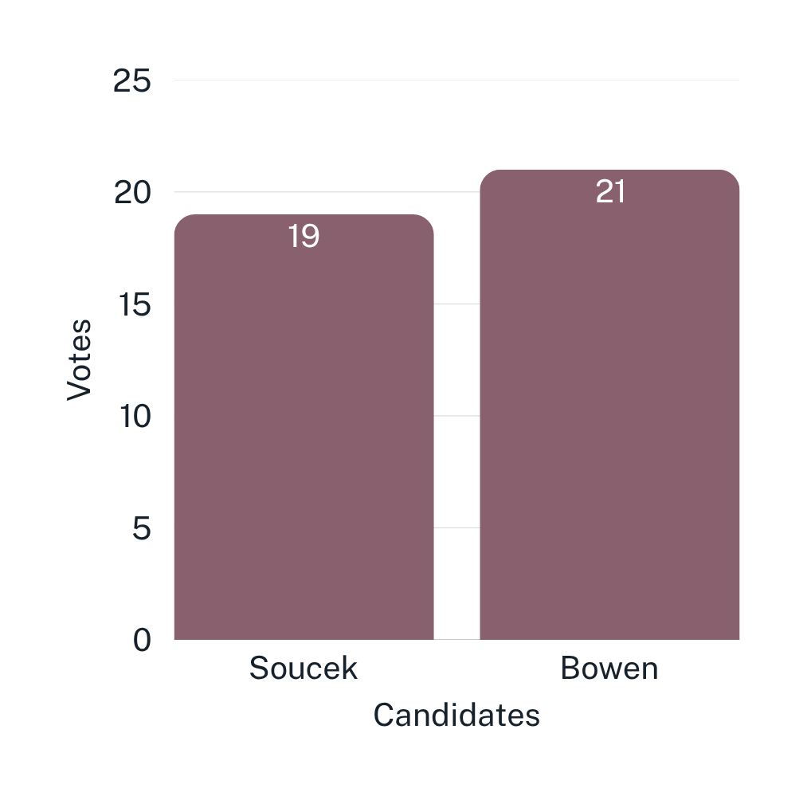
ROUND 3
Example Election
THE QUOTA TO BE ELECTED IS: 21
This one isn’t real
BOWEN WINS
Bowen has reached the quota and is therefore elected. Congratualtions to Bowen!

Slide 9
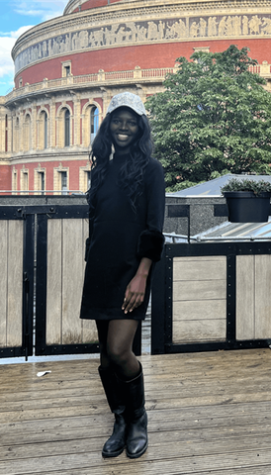
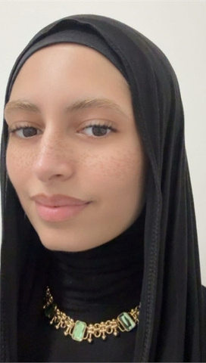
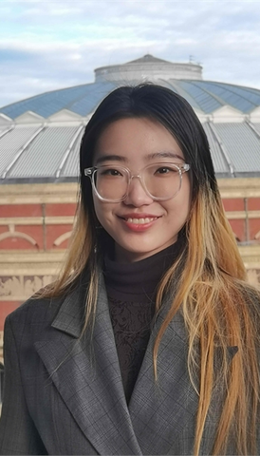
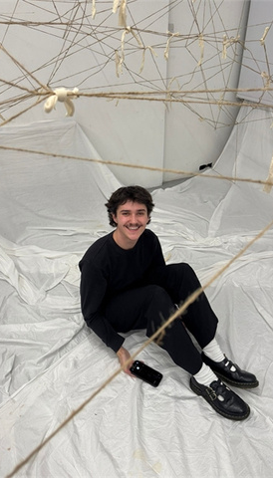
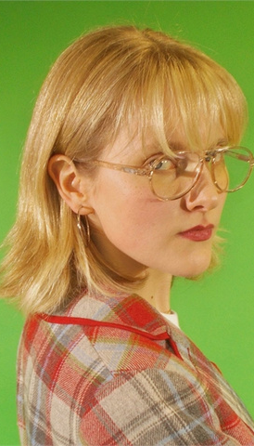
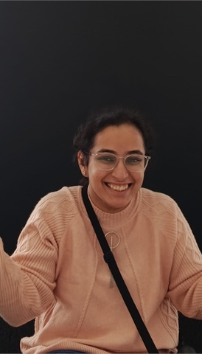
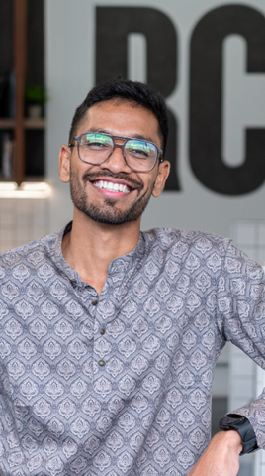
Candidates - President Votes: 768 Quota: 384
Leona Chang
Mia Hasluck
Pankhuri
Soni
Roshan Pendor
R.O.N.
Crystal Acqua
Marwa Hafouda
Eli Heijink

Slide 10
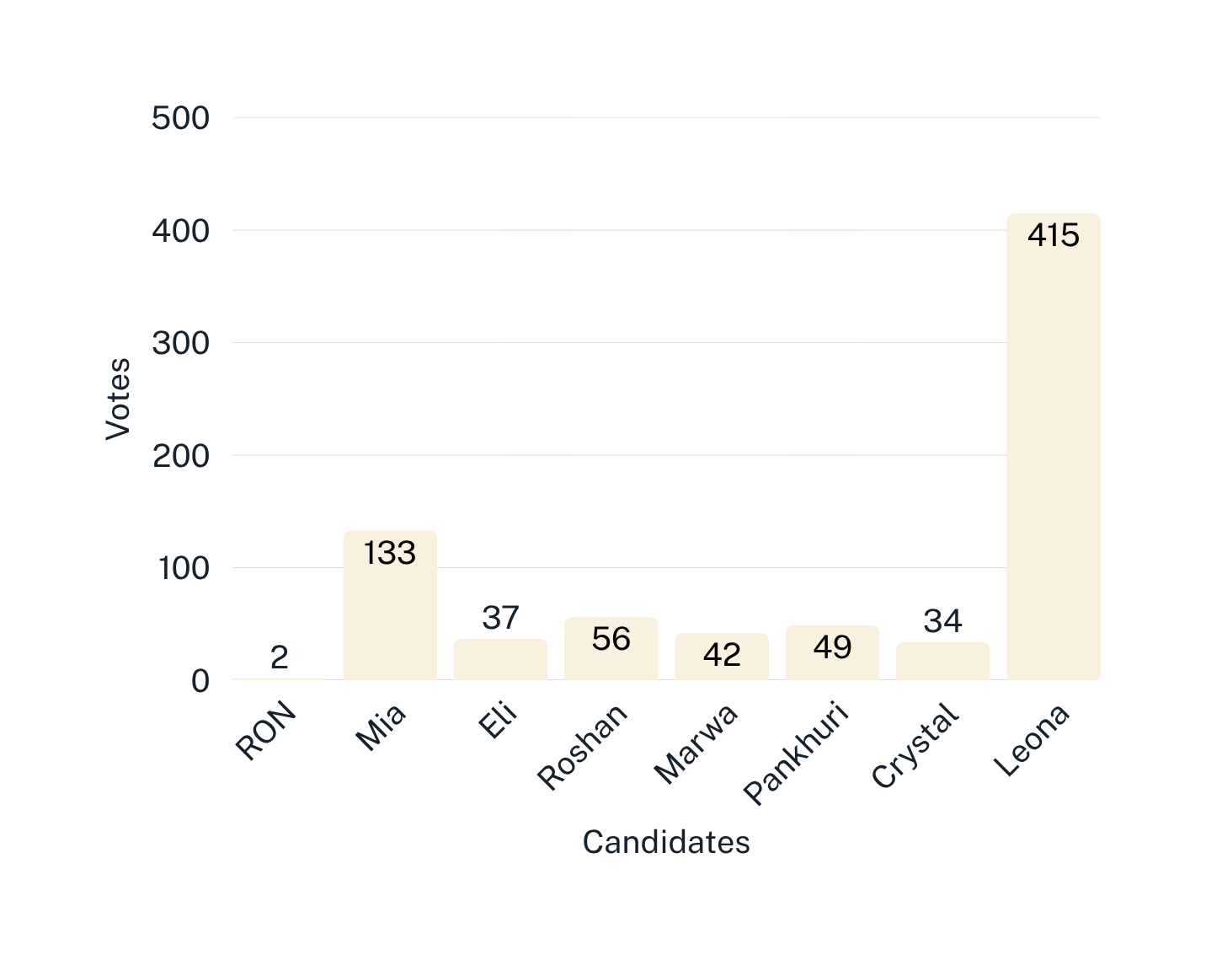
ROUND 1
President
THE QUOTA TO BE ELECTED IS: 384
Leona is Elected
Leona has enough votes to meet the quota and so is elected as President of the Royal College of Art Students Union for 2025-26

Slide 11
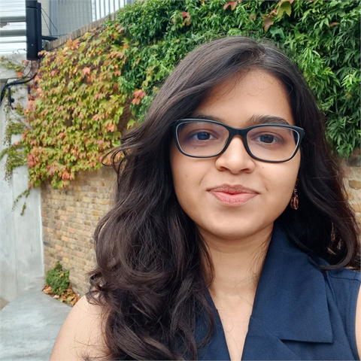
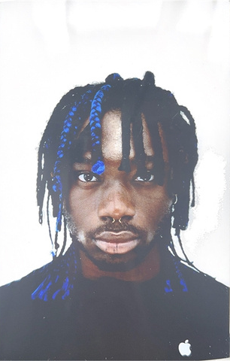
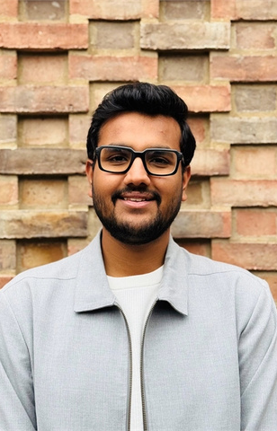
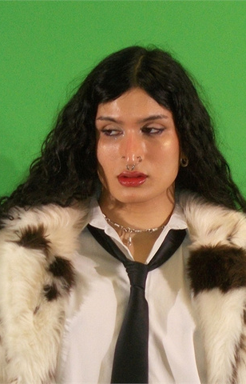
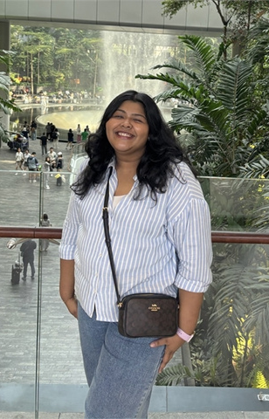
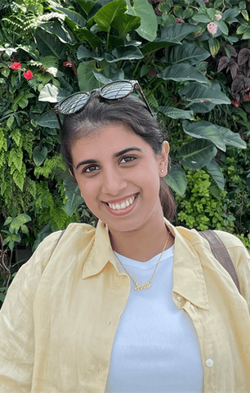
Candidates - Vice President Votes: 634 Quota: 317
Zainab Goriawala
Tobechukwu Ogbolu
Siddhant Garg
Chahat Ahmad
Asmita Khadakkar
Anandita Ashish Patil
R.O.N

Slide 12
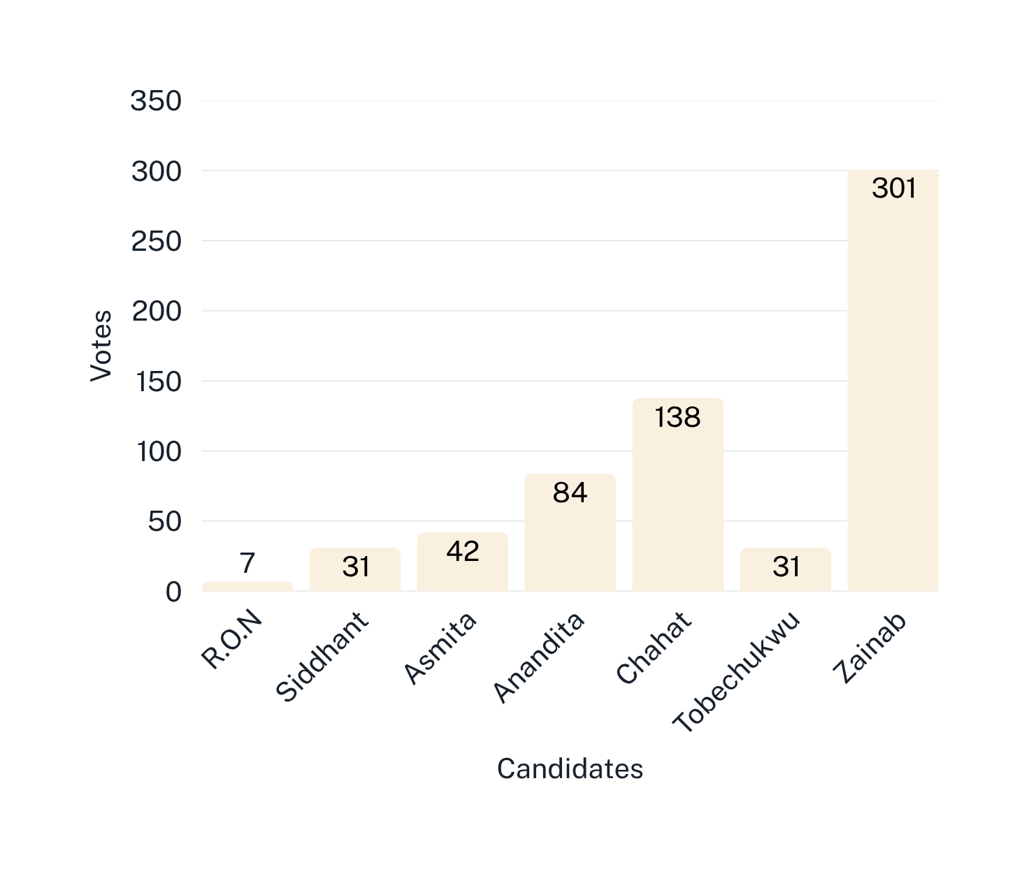
ROUND 1
Vice President
THE QUOTA TO BE ELECTED IS: 317
R.O.N. is Eliminated
Because no candidate reached the quota the candidate with the least votes is eliminated and their votes redistributed.

Slide 13
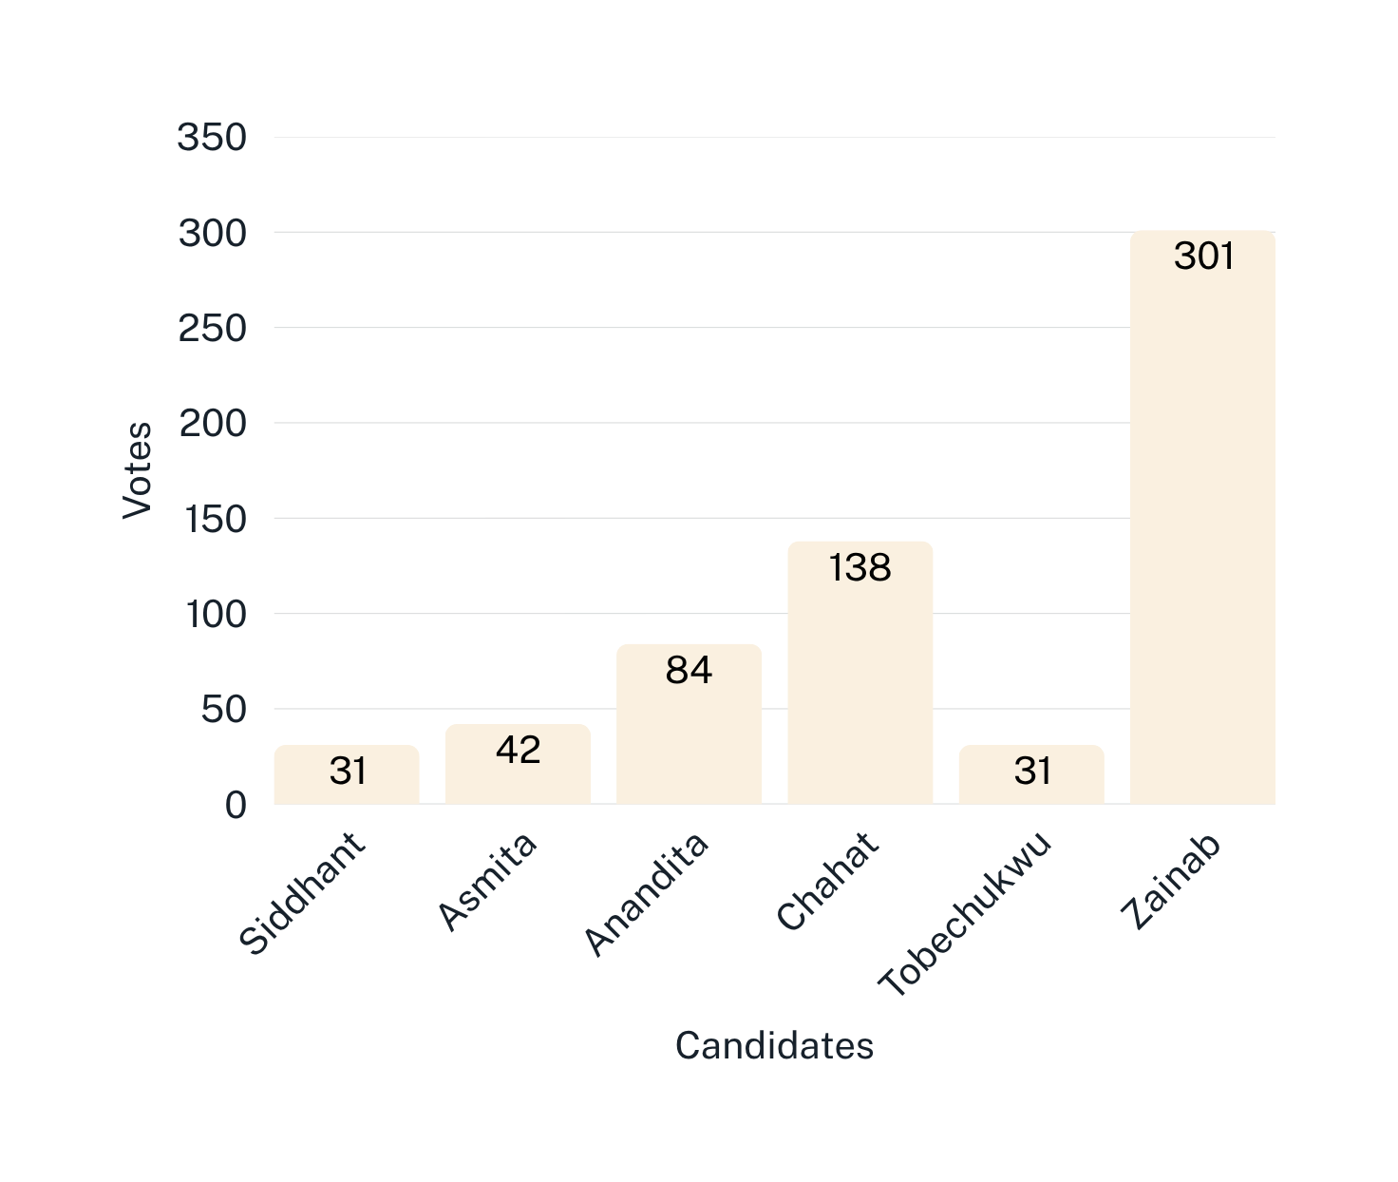
ROUND 1
Vice President
THE QUOTA TO BE ELECTED IS: 314
Siddhant is Eliminated
Because no candidate reached the quota the candidate with the least votes is eliminated and their votes redistributed.

Slide 14
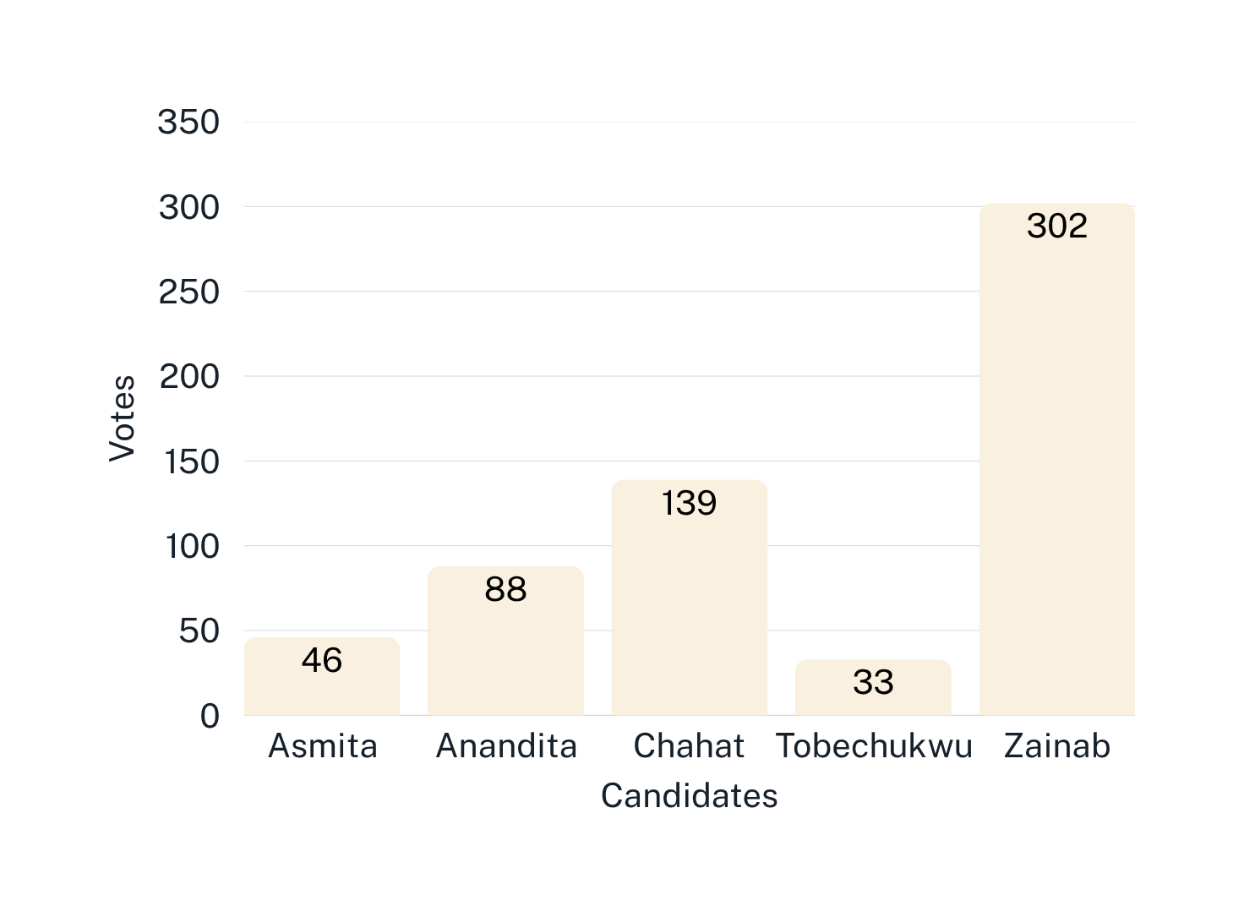
ROUND 1
Vice President
THE QUOTA TO BE ELECTED IS: 304
Tobechukwu is Eliminated
Because no candidate reached the quota the candidate with the least votes is eliminated and their votes redistributed.

Slide 15
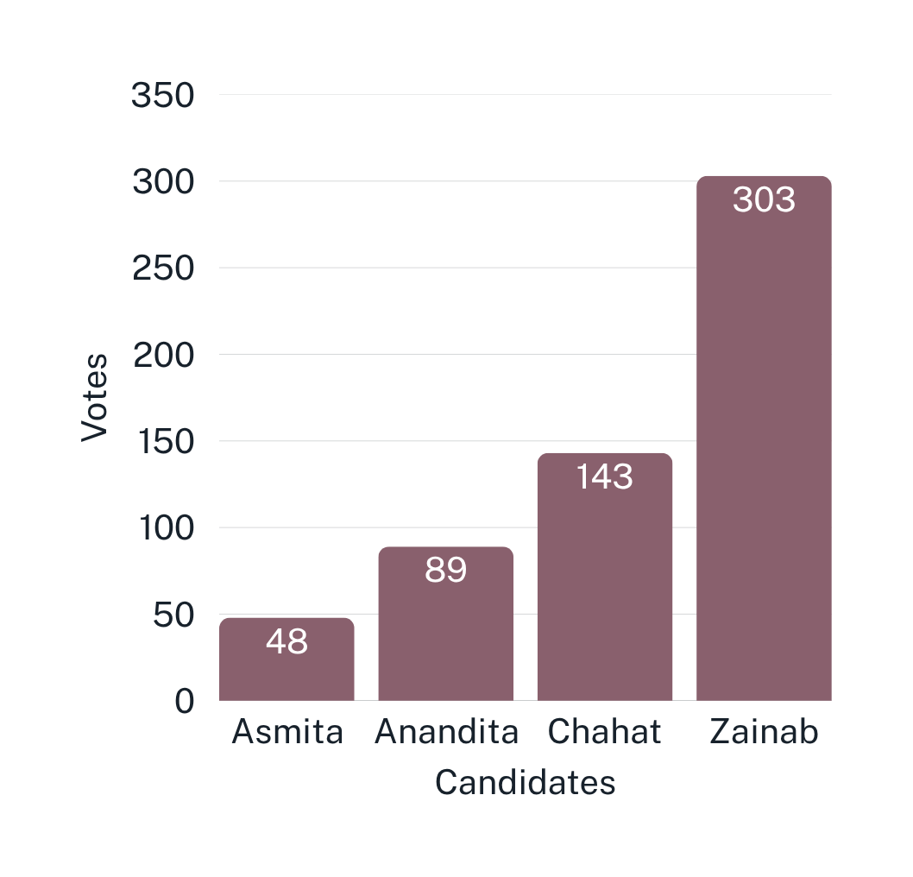
ROUND 3
Vice President
THE QUOTA TO BE ELECTED IS: 292
Zainab is Elected
Zainab has enough votes to meet the quota and so is elected as President of the Royal College of Art Students Union for 2025-26

Slide 16
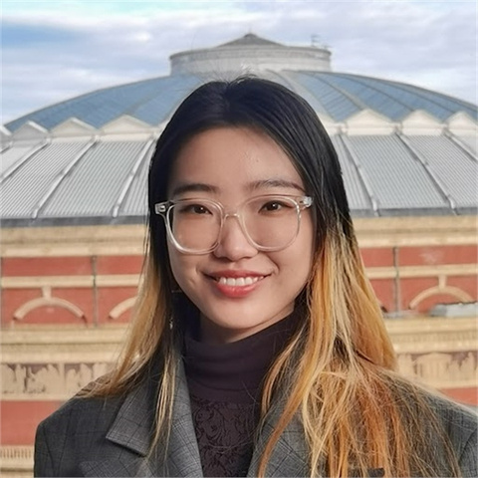
Final Results - Congratulations to our winners!
Leona Chang -
President
Zainab Goriawala - Vice President

Slide 17
Thanks and enjoy the rest of the evening!

